Slide 1
Escape Room Python Game
Project 2
Bárbara Muniz
Bárbara Muniz

Slide 2
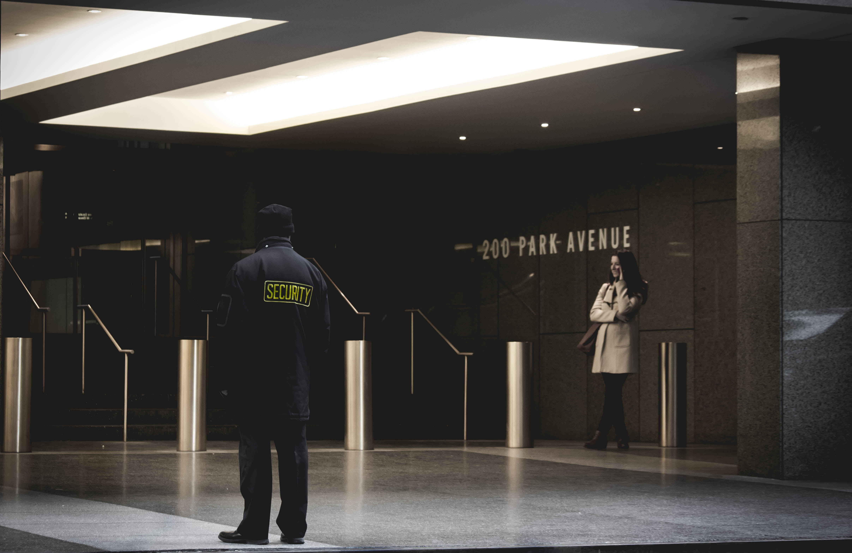
Goals:
Applying Python programming skills in solving a real problem;
Developing the Escape Room game using Python based on the game design.
Requirements:
Implementing different features;
Using different libraries.
Theme: Bank of Portugal
About the project

Slide 3


Features
Code Input
Decision Making
Random code (case sensitive) given to access the bank safe.
Whether would like to play the game or not. If not, the player exists the game.
Replay
Decision making (case sensitive) on playing the game when it ends or when the player lose.
Image/Audio Display
Throughout the game.
Username/Time Saved
Username (only letters, no space, capitalized) and time playing the game saved on Excel file,
Lose Game
When making the wrong move, the player loses and exists the game.

Slide 4















Map
Door D
Code
Key Door D
Restroom
Key Door A + Gold
Key Door C
Door B
Safe Room
Reception Room
Door A
Meeting Room
Door C
You wake up here
Key Door B

Slide 5
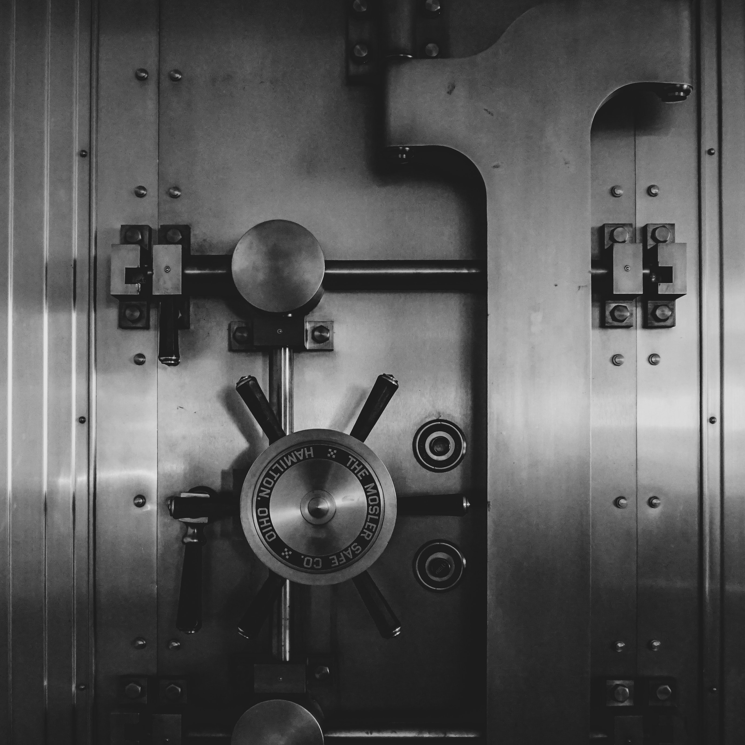
Pandas;
IPython: interactive Python shell;
OS Module: interaction with operating system;
﻿openpyxl: reads/writes Excel 2010 xlsx/xlsm/xltx/xltm files;
Sys: Python runtime environment manipulation;
Time;
Random.
Libraries
Notes:
Pandas: introduces 2 types of objects for storing data: Series and DataFrames.
IPython: interactive Python shell. It allows displaying images/audio as an output.
OS Module: provides functions that allows interaction with the operating system.
﻿openpyxl: reads and writes Excel 2010 xlsx/xlsm/xltx/xltm files.
Sys: provides functions and variables to manipulate Python runtime environment.
Time: retrieves the current time.
Random: gives a random float number.

Slide 6







Upgrades/Next Steps
More interactive
Start game outside
More challenging
Rank by time
User/Group friendly
Add rooms
(names, time track, replay)

Slide 7

GAME OVER
Thank you!

